Slide 1

Rainfall prediction
Presented By:
Priyadharshini M
Shubigsha G
Sindhuja G

Slide 2
Description
The Rainfall Prediction aims to develop a robust predictive model for forecasting rainfall. This project leverages advanced machine learning techniques, historical weather data, and atmospheric variables to create accurate and reliable rainfall predictions. Accurate rainfall forecasting is crucial for agriculture, water resource management, disaster preparedness, and daily planning.

Slide 3
Technologies
Python: For data processing, machine learning, and visualization.
Scikit-Learn: For machine learning algorithms.
Pandas and NumPy: For data manipulation and numerical operations.
Matplotlib/Seaborn: For data visualization.
TensorFlow: For deep learning models.

Slide 4
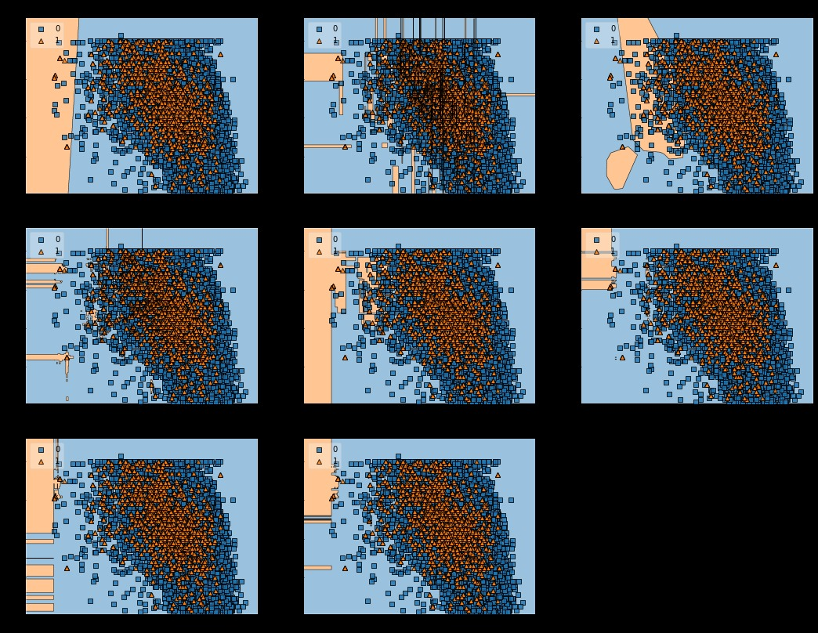
output

Slide 5
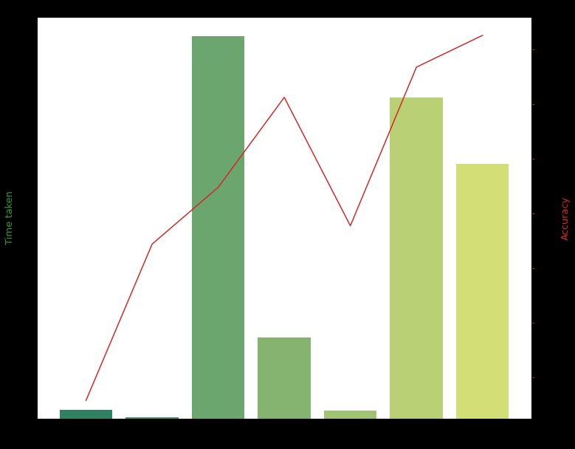
output

Slide 6


